Slide 1

Understanding the Career Aspirations of Gen-Z
Exploring the mindset of Gen Z for their future work.
Presented by Syed Sithik.

Slide 2

Learning Roadmap and Project Flow
Introduction
Problem statement & business research document
Data Collection
Gathering data via Google Forms & platforms
Data Cleaning
Fixing and removing corrupted or incomplete data
Analysis & Dashboard
Business questions solved; dashboard creation
Project Flow: raw data → cleaning → analysis → visualization → presentation.

Slide 3
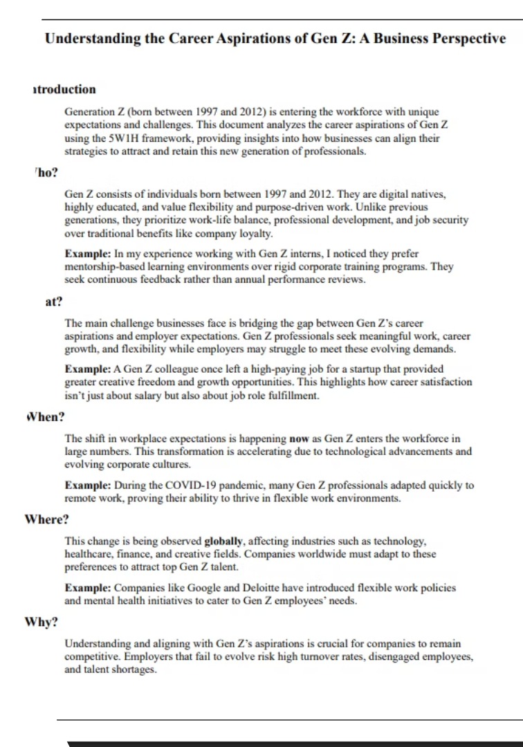
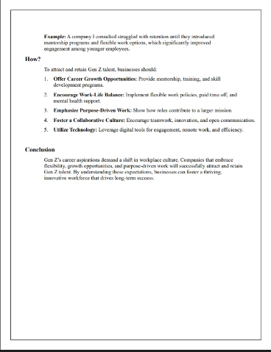
Problem Statement
What is Happening?
Gen Z seeks flexible, purpose-driven careers and values mental health.
Why is That a Problem?
Companies unprepared; causes job uncertainty and frustration.
Objectives
Understand Gen Z's true desires
Guide employers and educators
Data-driven career path insights

Slide 4

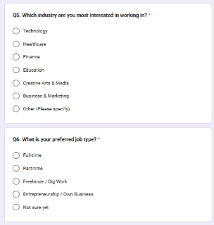
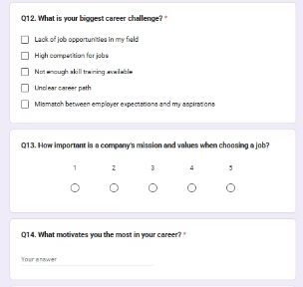
Data Collection Approach
Data sourced mainly from LinkedIn, Instagram, Google Forms.
Broad, diverse samples ensure balanced representation.

Slide 5

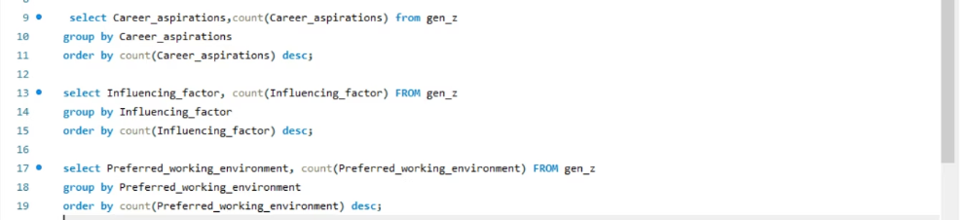
Data Cleaning and SQL Analysis
Imported data via MySQL Workbench from CSV and Excel files
Resolved 5 business questions using SQL queries
Filtered and ensured clean, formatted data

Slide 6
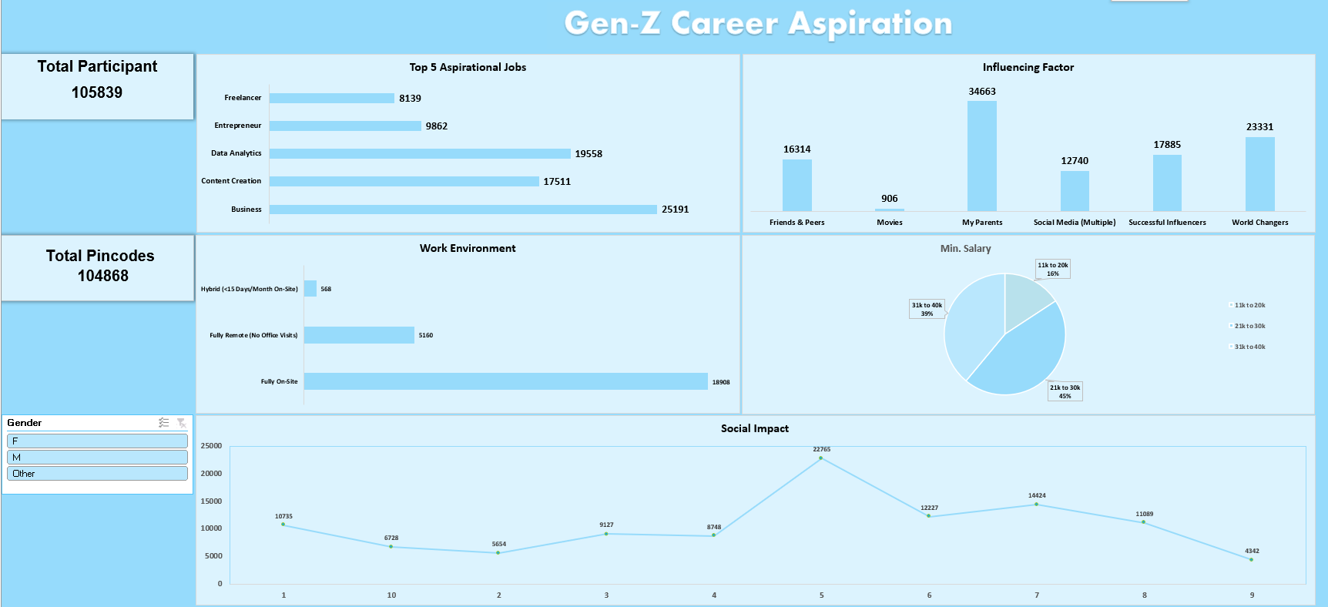
Executive Dashboard Overview
360-degree view of key Gen Z career aspiration metrics.
Helps leadership make data-driven strategic decisions.

Slide 7
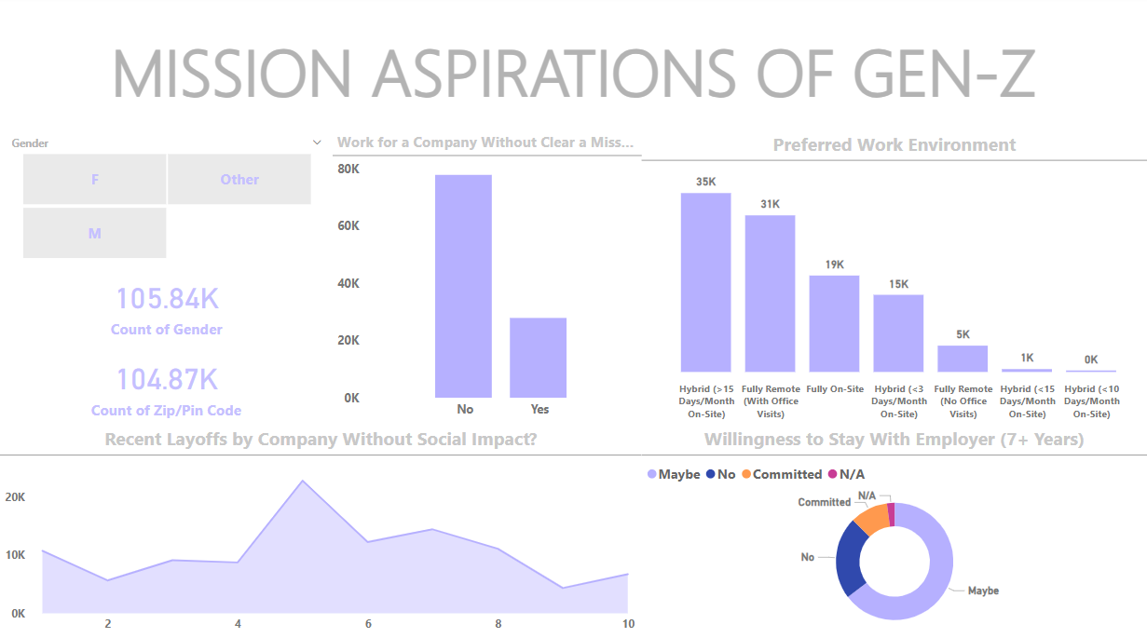
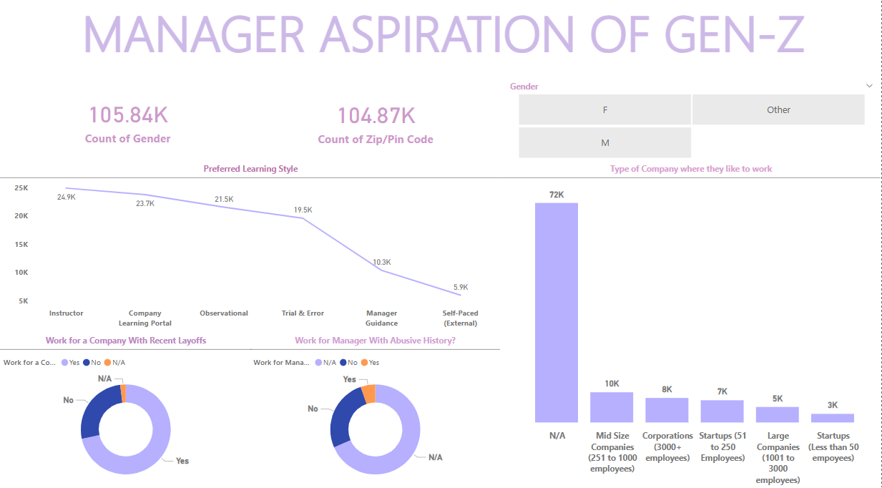
Functional Dashboards: Mission & Manager Aspirations
Mission Aspiration
Gen Z seeks meaningful work aligned to values.
Manager Aspiration
Desire for leadership roles with impactful influence.

Slide 8

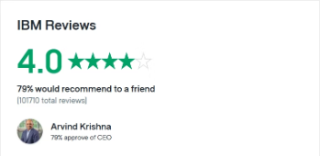
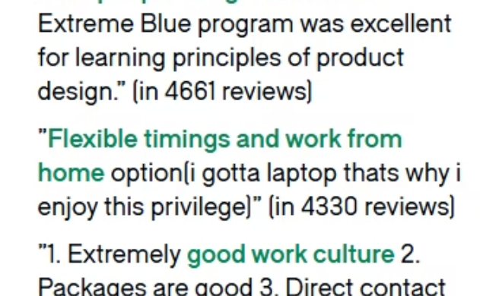
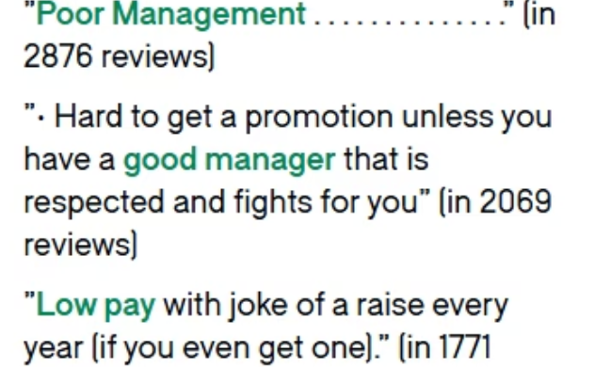
About IBM and Partner Context
IBM Overview
Expertise in AI, Cloud, Quantum, Cybersecurity.
Founded 1911, Armonk NY, CEO Arvind Krishna.

Slide 9

Final Insights from Indian Gen Z Survey
Survey via LinkedIn and Instagram.
5,000 completed responses and 50,000 data points collected.
1,800 unique postal codes covered across India.
Diverse geographic representation for robust insights.

Slide 10
Thank You!

